Slide 1
REAL-TIME CHESS GAME ANALYZER
Serden Sait Eranil
Veysel Colak
Firdevs Su Aydin

Slide 2
Outline
Motivation
Project Steps & Work Distribution
Project Pipeline (ROS Nodes & Topics)
Deeper Look Into Project Steps
Accuracy and Delay Results
Demo
Future Scope

Slide 3
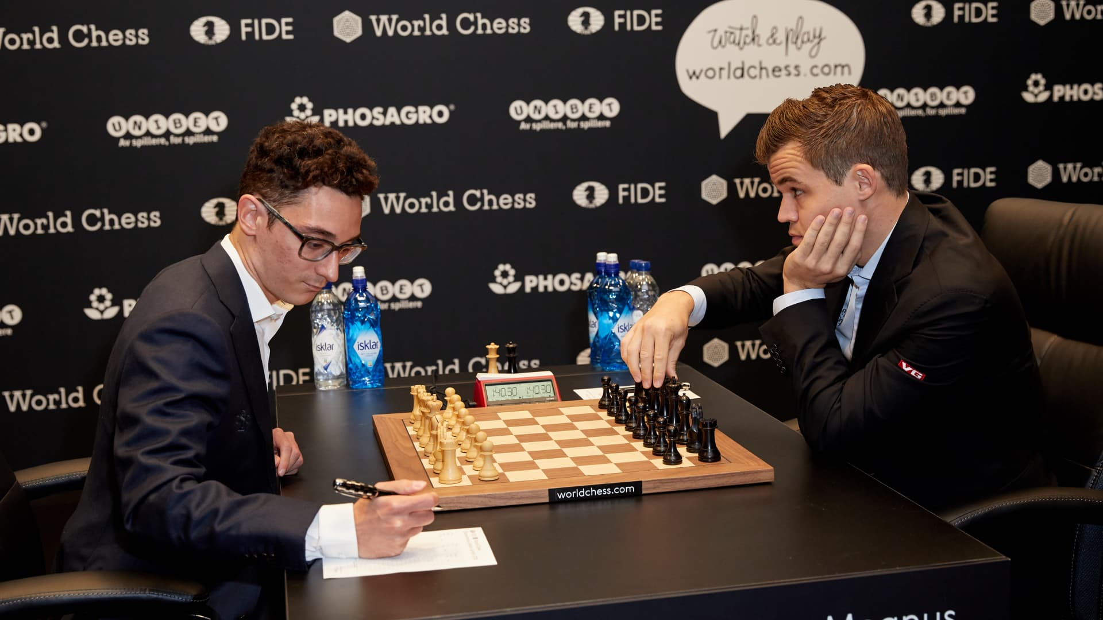
Motivation
Automate recording of the moves
Instead understand the moves with camera and save them

Slide 4
Project Steps & Work Distribution
Data Collection & Annotation | YOLO Model Selection | Piece, Checkerboard and Hand Detection
Serden Su Veysel | Su Serden | Su Serden
Game State Management | Visualization | ROS Pipeline & Workspace
Veysel | Serden | Veysel

Slide 5
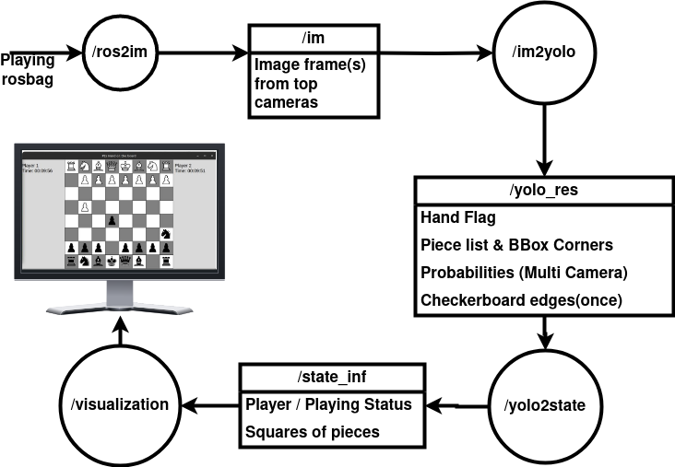
Project Pipeline (ROS Nodes & Topics)
Veysel

Slide 6
Deeper Look Into Project Steps

Slide 7
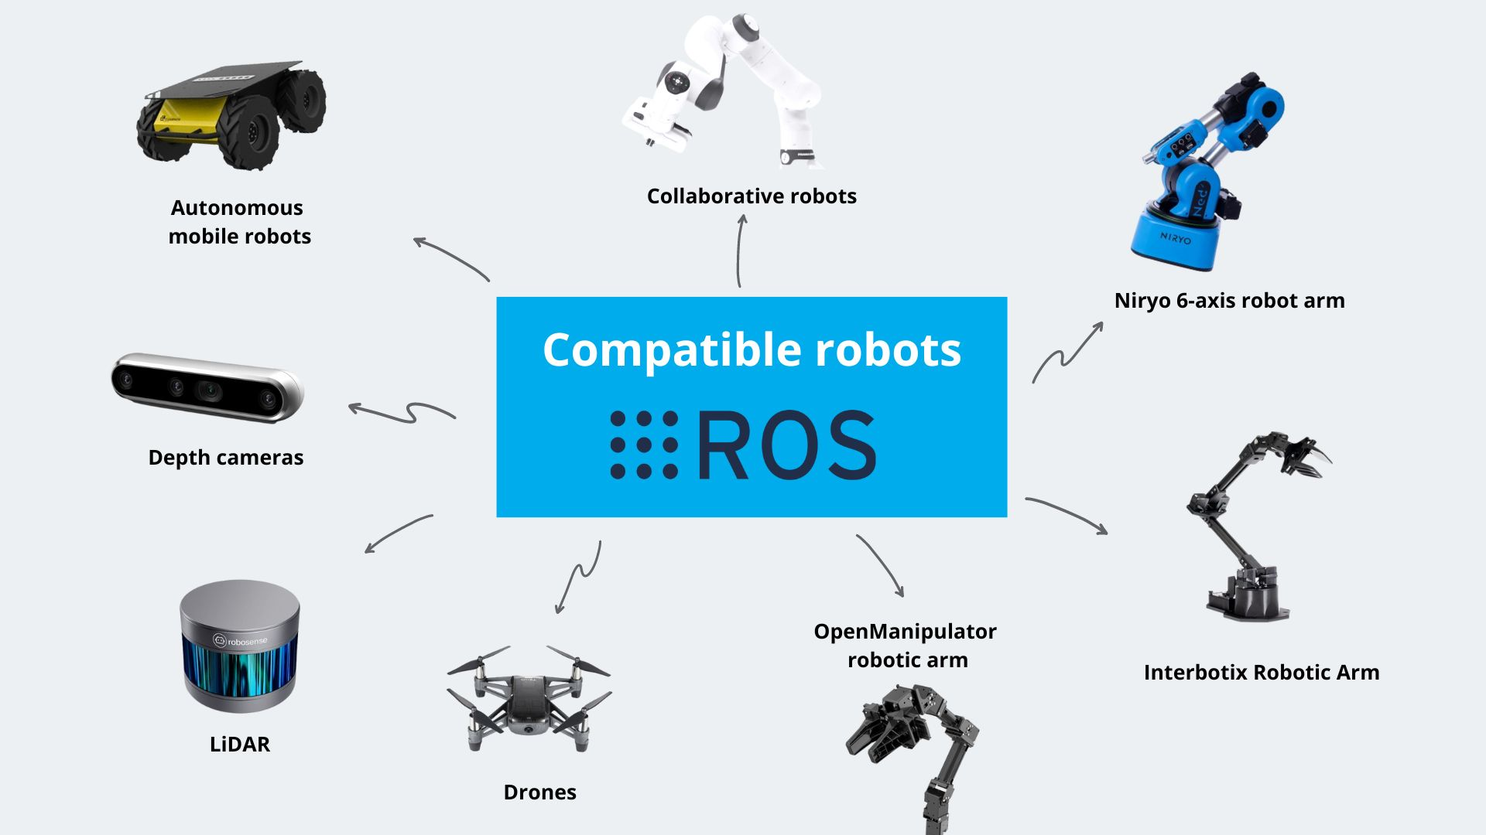
ROS
Robot Operating System is...
a robotics workframe.
a library for C and Python.
a middleware between distributed system.
"Nodes", "Topics", "Services", "Actions" ...
Veysel
Notes:
Minimal modules called "nodes".
"Nodes" can communicate via streams called "topics". Nodes can "publish" or "subscribe"
"Nodes" have "services" and "actions" for client/server type interactions
<number>

Slide 8
What does ROS bring?
The "communicating nodes" structure
In robotics domain also...
Veysel
Notes:
of ROS enables to use different nodes on different devices independently.
Standardization of robotics development
High-Level / Low level abstraction
<number>

Slide 9
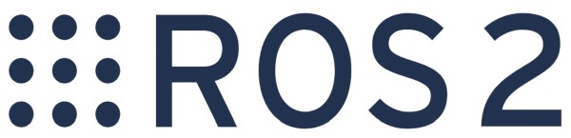

But there are two of them!
ROS has two versions: ROS & ROS2.
No Masters
Message QoS profiling
Due to lab computers and bag files,
we have moved our project to ROS1
Veysel
Notes:
Also: EOL, Aggressive Patches, Microsoft/MacOs...
<number>

Slide 10
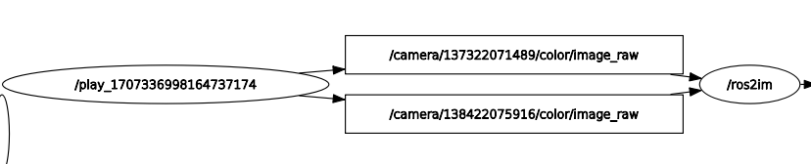
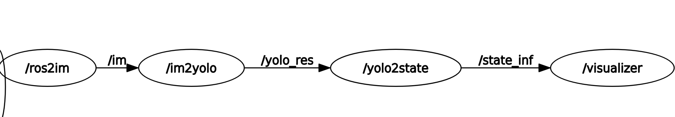
ROS Implementation (with Camera Node)
Veysel

Slide 11
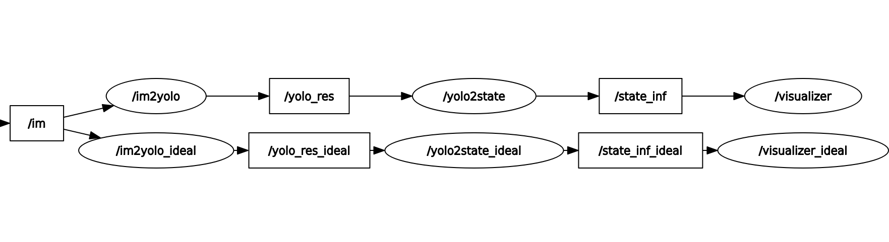
ROS Implementation (with Test Node)
Utilize the ROS node2node communication
On parallel use a "~perfectly arranged determiner"
Use the branch for each step after "/im" topic
Veysel, Serden

Slide 12
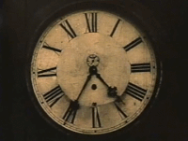
ROS Reading Camera (/ros2im)
Other nodes subscribe 1 topic
But /ros2im subscribes 2 topics
They should be combined.
Approximate Time Synchroniser
Veysel

Slide 13
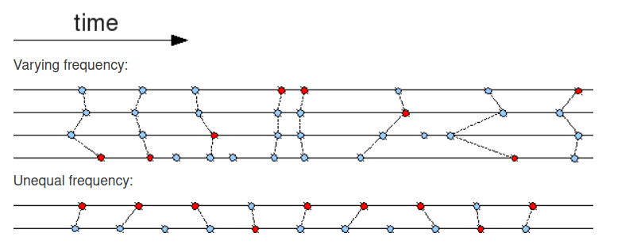
Time Synchronization in ROS
TimeSynchronizer:
Perfect but Unimplementable
ApproximateTimeSynchronizer:
Frame loss possible but works
Veysel

Slide 14
DATA ANNOTATION
TRAINING AND TEST

Slide 15
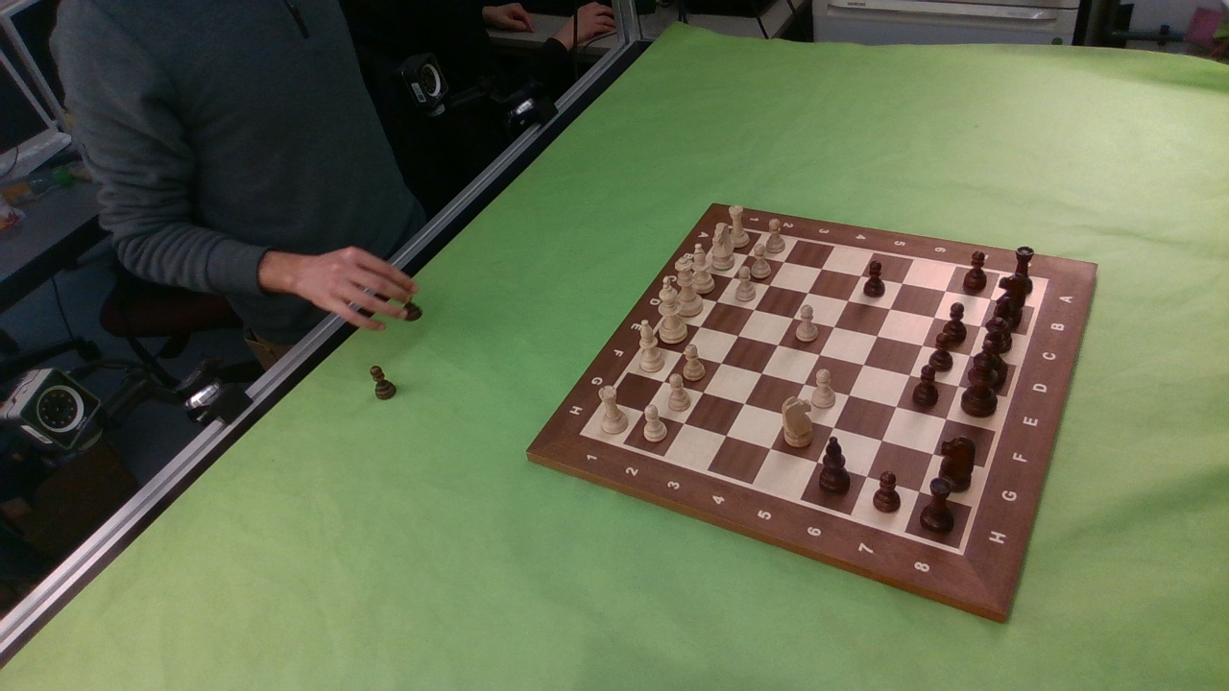
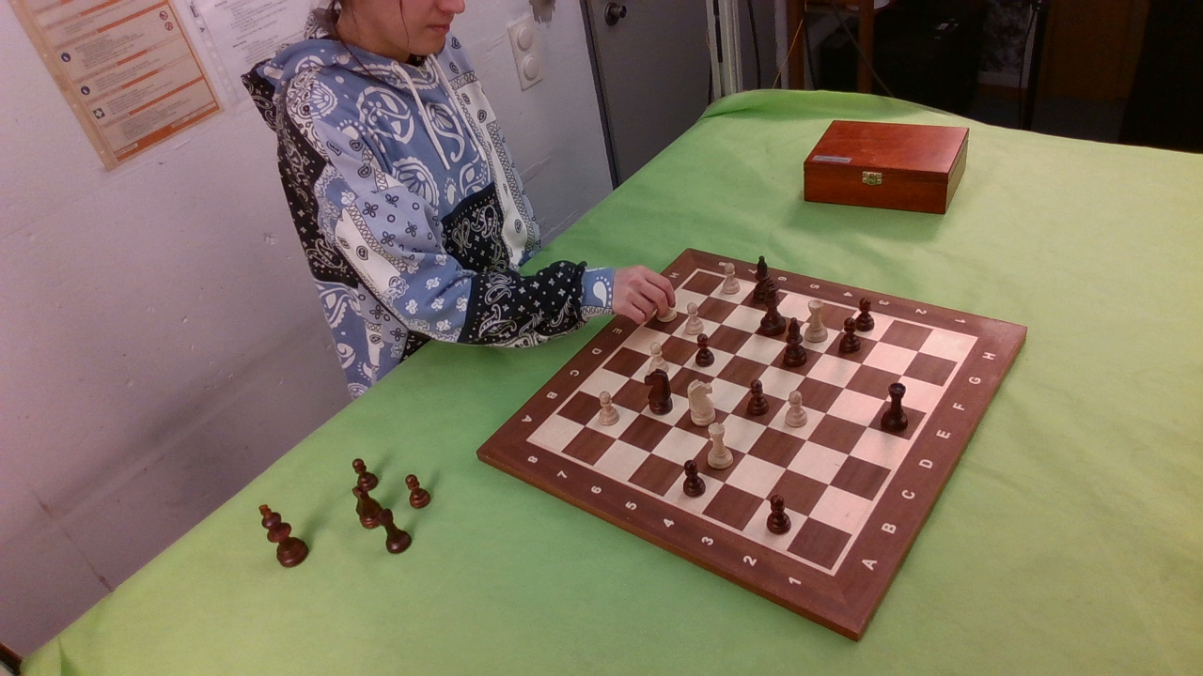
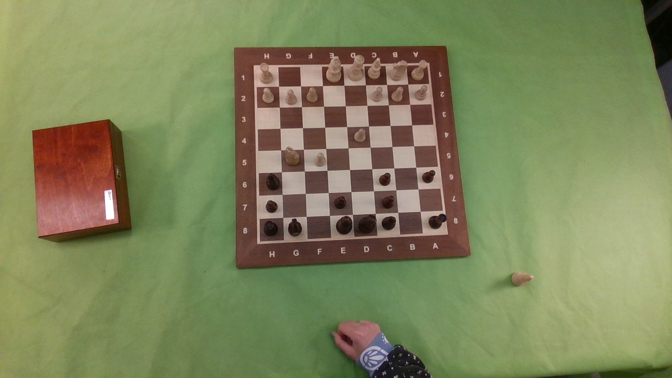
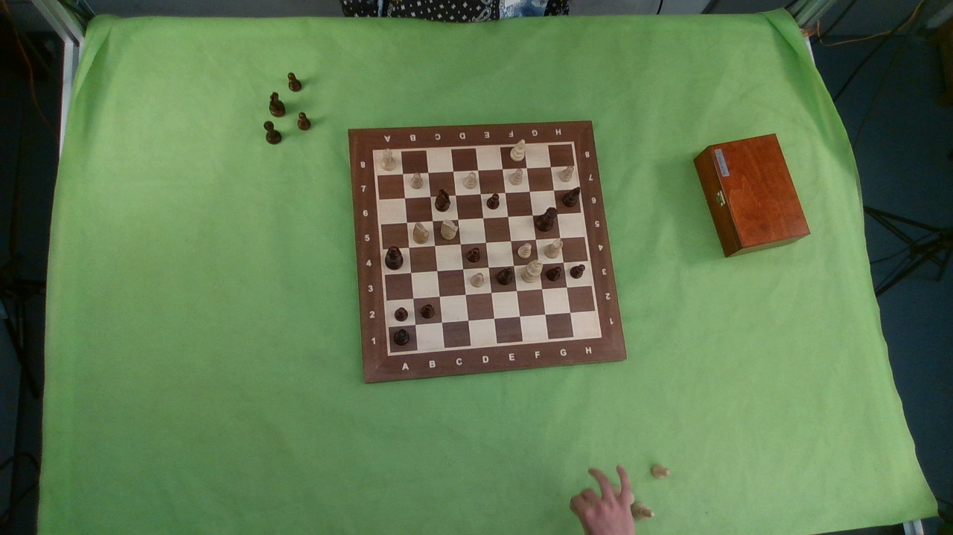
Data Collection and Annotation
8 Recordings
4 Cameras: 2 top views, 2 side views
Su, Serden

Slide 16
Data Collection and Annotation
Records 1 to 6
Top View1
Top View2
Side View1
Side View2
4 Images
7 Images
7 Images
4 Images
Training Dataset:
6 recordings, 4 cameras
Total of 132 training
images
Su, Serden

Slide 17
Data Collection and Annotation
Record 7
Top View1
Top View2
10 Images
10 Images
Validation Dataset:
1 recording, 2 top views
Total of 20 validation
images
Test Dataset:
1 recording, 2 top views
Total of 20 test
images
Record 8
Top View1
Top View2
10 Images
10 Images
Su, Serden

Slide 18
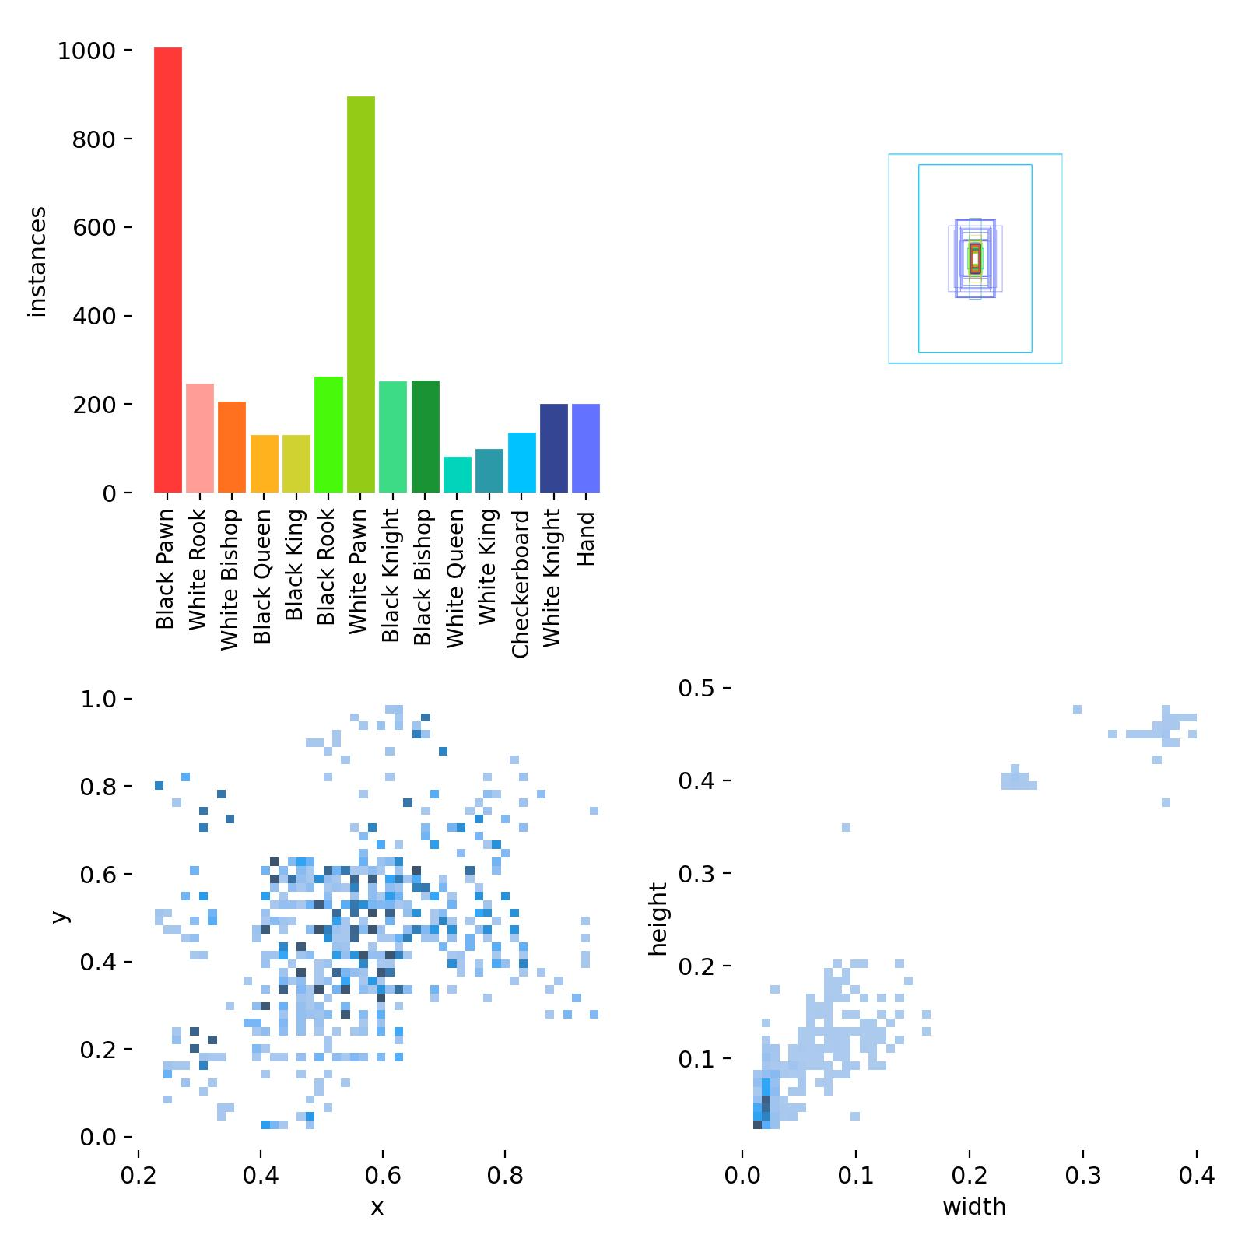
Data Collection and Annotation
Data Distribution:
12 piece + hand + checkerboard
Not evenly distributed
Su, Serden

Slide 19
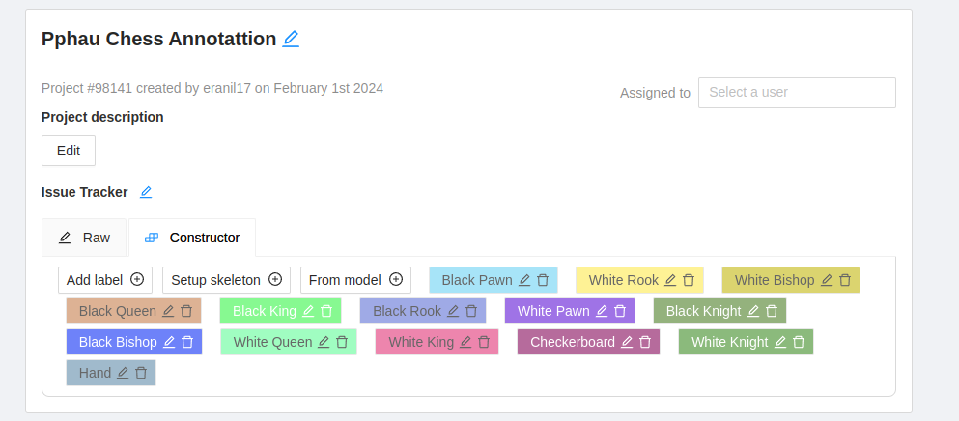
CVAT: Computer Vision Annotation Tool
Easy-to-use, open-source, collaborative web-based tool
Allows the use of state-of-the-art segmentation methods (e.g., Segment Anything, HRNET)
Su, Serden

Slide 20
Why didn't we use MIVOS?
Poor quality of the pieces
Insufficient support of instances
Fast hand movements
Too chaotic piece distribution
Solution: Through use of CVAT, add some manual input
Su, Serden

Slide 21
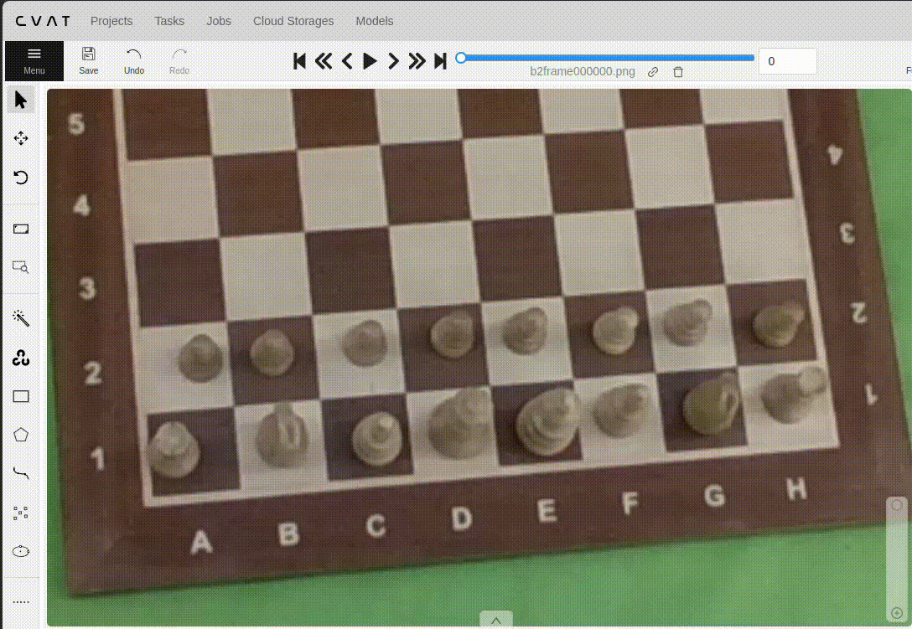
How did we do the annotation in CVAT: GIF
Su, Serden

Slide 22
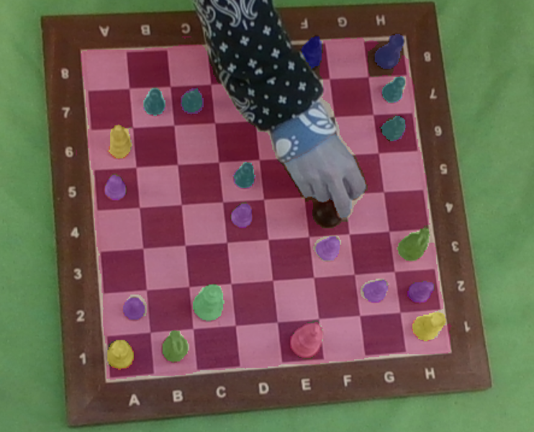
Final annotation outcome per frame
Su, Serden

Slide 23
YOLO MODELS

Slide 24

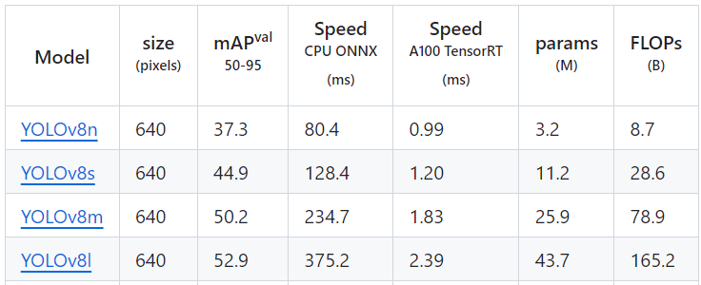
YOLO Model Selection
4 sizes of YOLO v8 model:
Nano
Small
Medium
Large
Figure: Parameters of YOLO models. Adapted from https://github.com/ultralytics/ultralytics

Slide 25
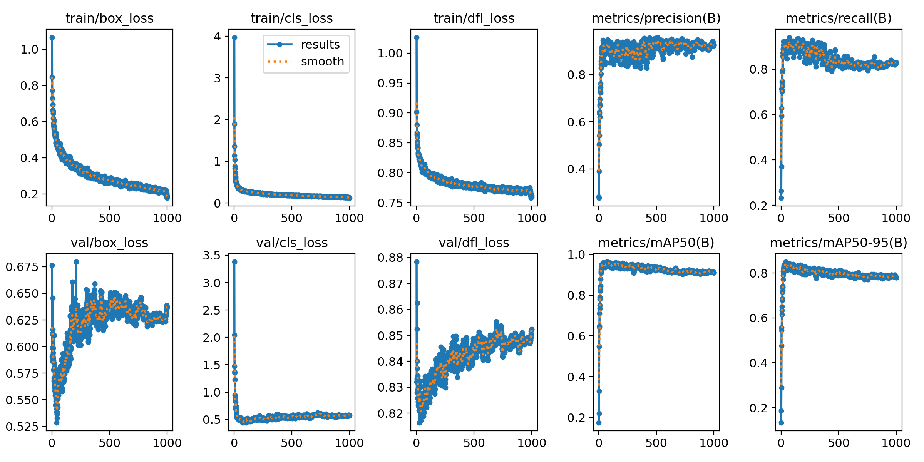
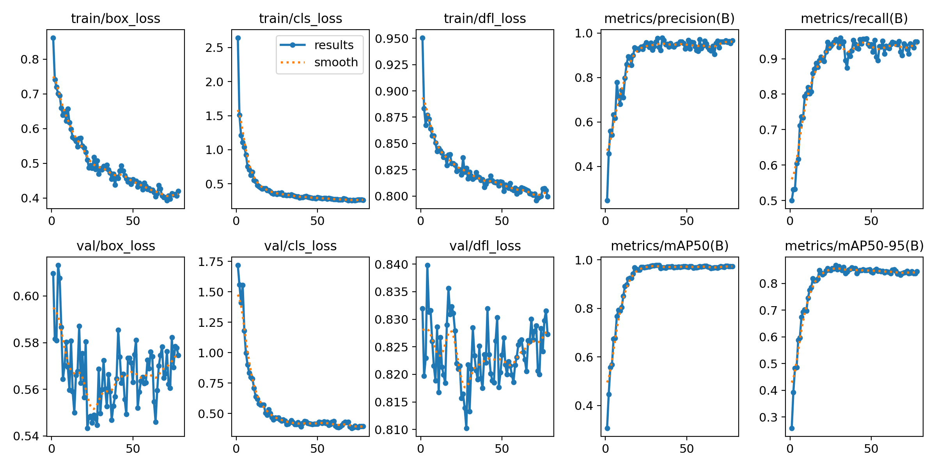
YOLO Model Selection
Training:
Avoid overfitting.
Figure1: Training curves for small model.
Figure2: Training curves for medium model.
Serden, Su

Slide 26
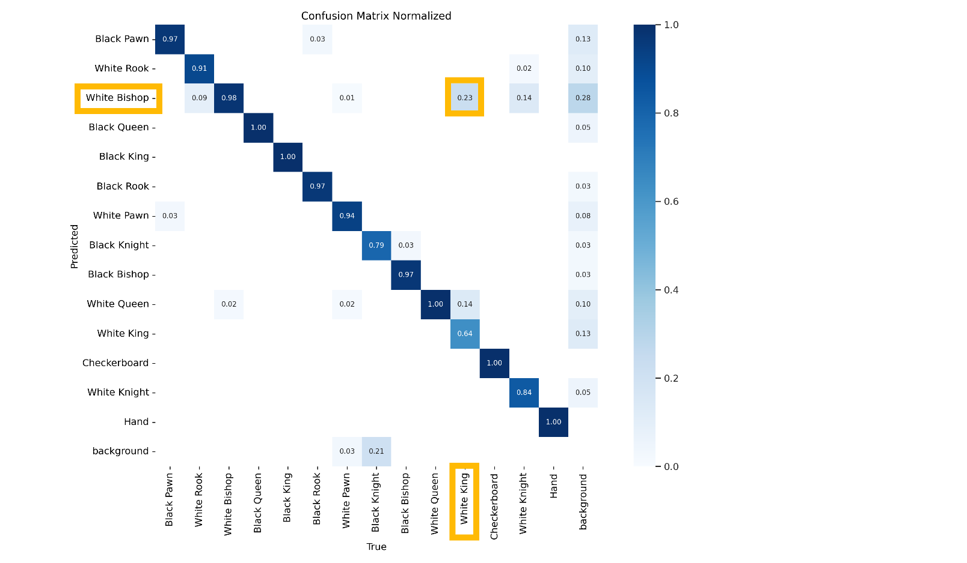
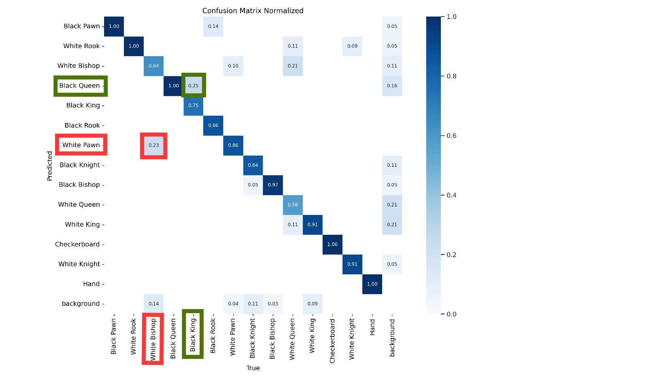
YOLO Model Selection
Test: Confusion matrices
Some pieces are confused with each other.
Figure 1: Confusion matrix for large model with test data
Figure 2: Confusion matrix for small model with test data
Serden, Su

Slide 27
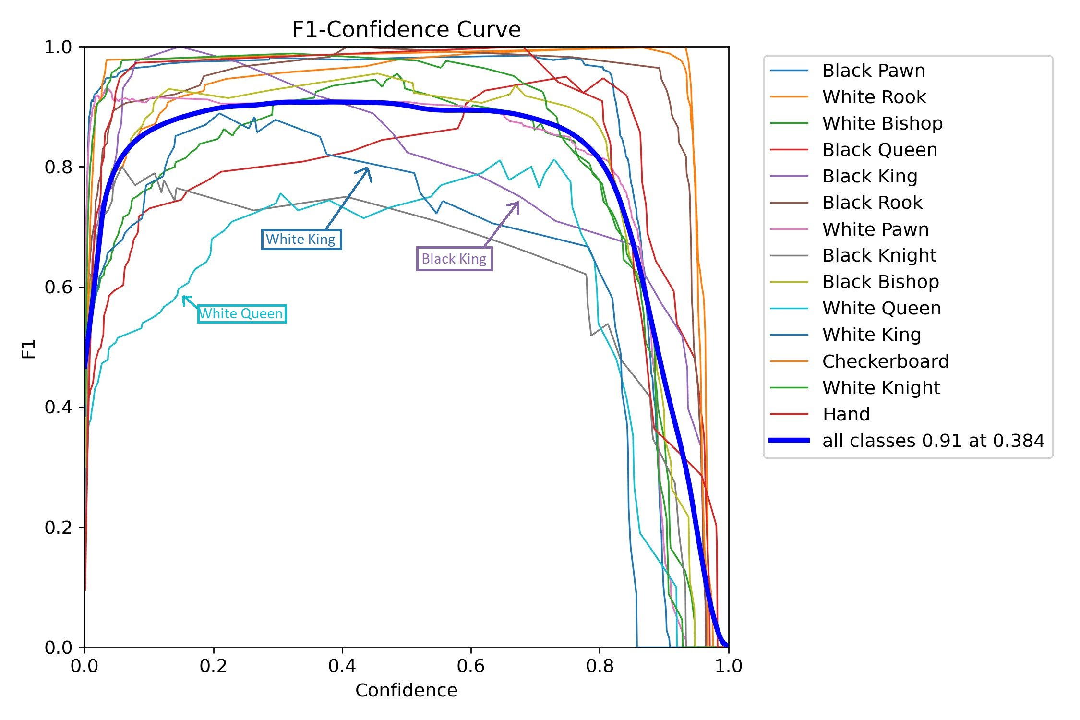
YOLO Model Selection
Test: F1 Scores​
Kings and Queens are harder to detect.
Figure: F1 Score of medium model
Serden, Su

Slide 28
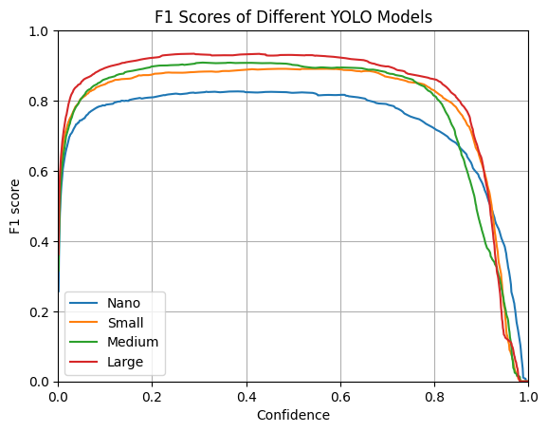
YOLO Model Selection
Test: F1 Scores
Confidence threshold is determined by F1 Score.
Medium model is selected.
Model | Max F1 S. | Confidence
Nano | 0.81 | 0.374
Small | 0.89 | 0.553
Medium | 0.91 | 0.384
Large | 0.93 | 0.274
Serden, Su

Slide 29
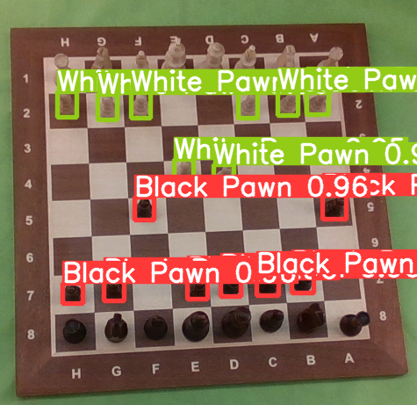
YOLO Model Selection
Some detection examples: Only pawns
Serden, Su

Slide 30
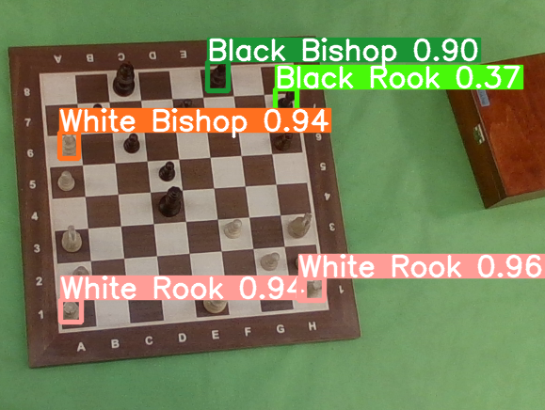
YOLO Model Selection
Some detection examples: Rooks and Bishops
Serden, Su

Slide 31
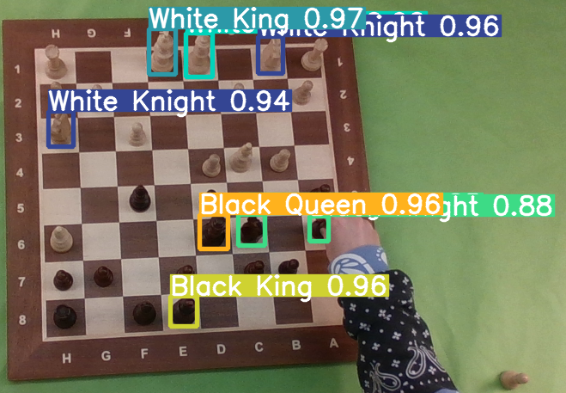
YOLO Model Selection
Some detection examples: Knights, Kings and Queens
Serden, Su

Slide 32
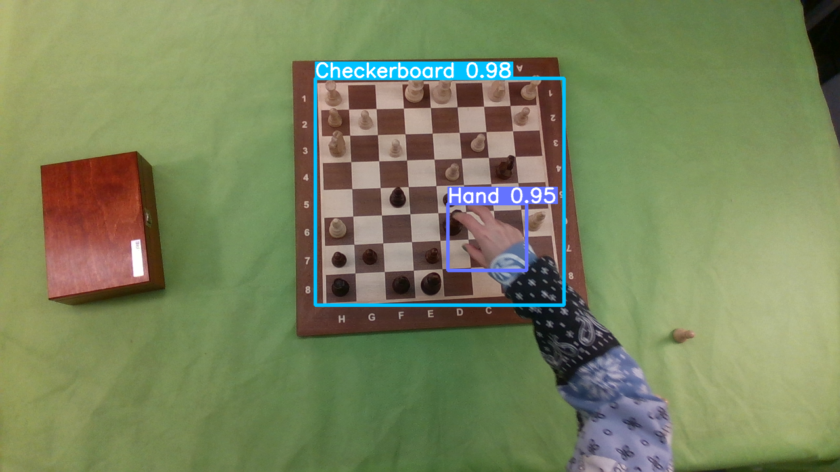
YOLO Model Selection
Some detection examples: Checkerboard and Hands
Serden, Su

Slide 33
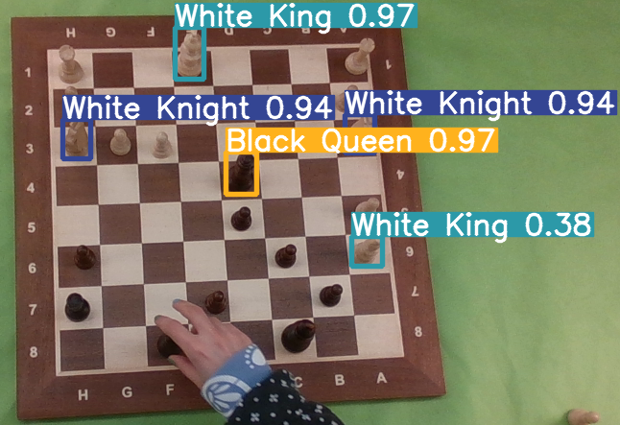
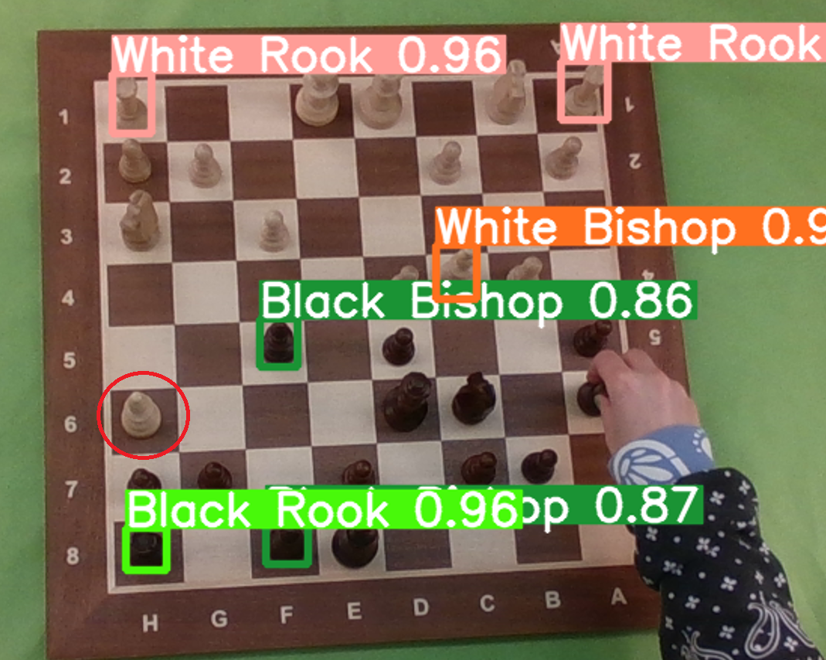
YOLO Model Selection
Detection Challenges:
White bishops are hard to detect.
Queens and kings are sometimes confused for each other.
Figure 1: Wrongly detected white queen
Figure 2: Undetected white bishop
Serden, Su

Slide 34
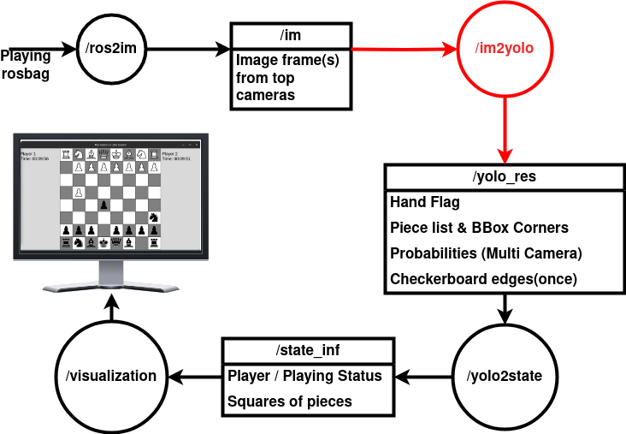
Piece, Checkerboard and Hand Detection
Su

Slide 35
Piece, Checkerboard and Hand Detection
Checkerboard coordinates
Hand flag
Piece classes
Piece bounding boxes
Piece probabilities
Frame(s)
Su

Slide 36
Checkerboard Corner Detection
Checkerboard Frame
Canny Edge Detection
Hough Line Transform
Sorting
Correct Corners
Harris Corner Detection
Sorted corner coordinates
Su

Slide 37
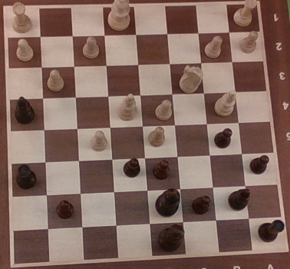
Checkerboard Corner Detection
Checkerboard Frame
Canny Edge Detection
Hough Line Transform
Sorting
Correct Corners
Harris Corner Detection
Sorted corner coordinates
Su

Slide 38
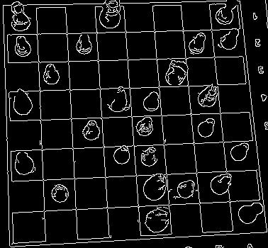
Checkerboard Corner Detection
Checkerboard Frame
Canny Edge Detection
Hough Line Transform
Sorting
Correct Corners
Harris Corner Detection
Sorted corner coordinates
Su

Slide 39
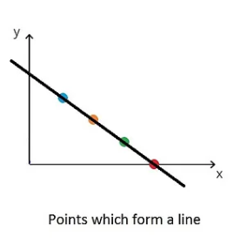
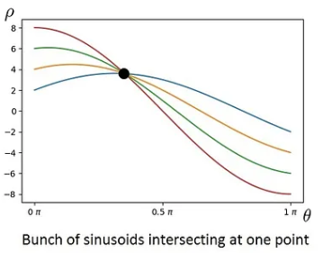
Checkerboard Corner Detection​
Hough-Line Transform:
Point -> Sinusoid
Intersection of sinusoids means line
Hough Transform
Figure 1: Line on image domain. Adapted from https://shorturl.at/lBOX5
Figure 2: Sinusoids on image domain. Adapted from https://shorturl.at/lBOX5
Su

Slide 40
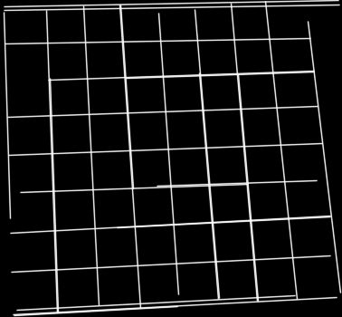
Checkerboard Corner Detection
Checkerboard Frame
Canny Edge Detection
Hough Line Transform
Sorting
Correct Corners
Harris Corner Detection
Sorted corner coordinates
Su

Slide 41
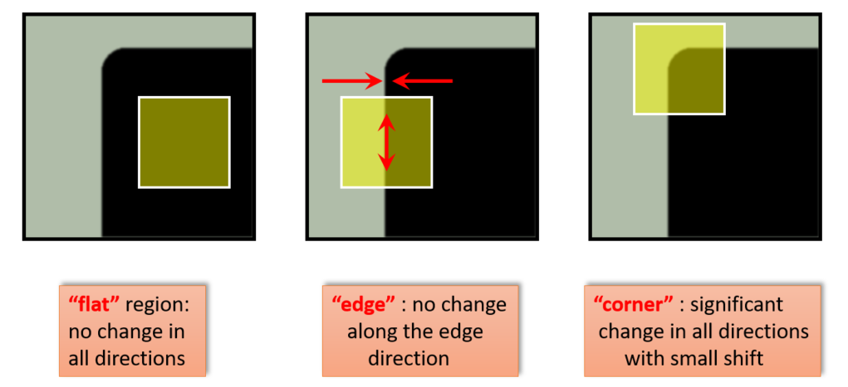
Harris Corner Detection: Basic Idea
Figure: Harris Corner Detection. Adapted from https://shorturl.at/jtwQ8
Su

Slide 42
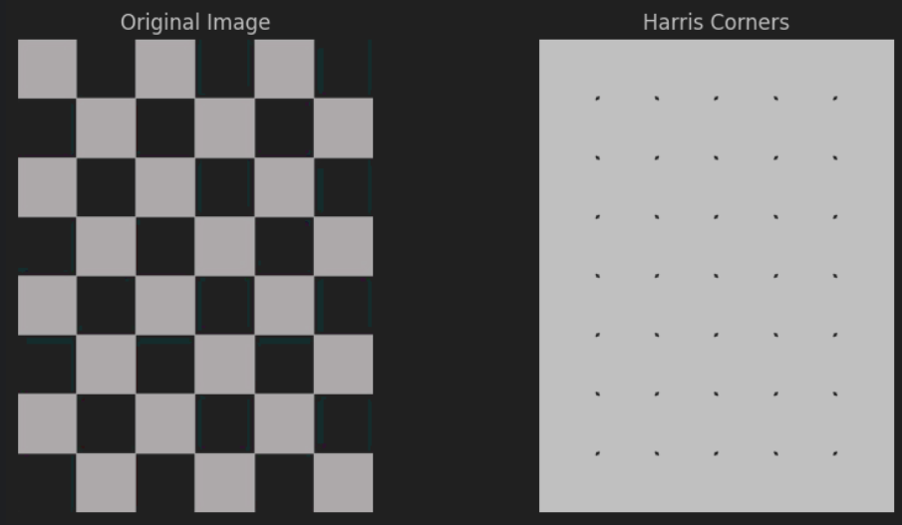
Harris Corner Detection: Good for chess
Su

Slide 43
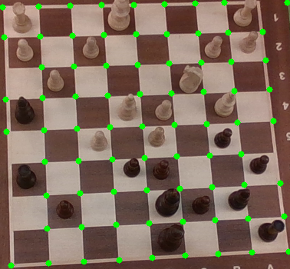
Checkerboard Corner Detection
Checkerboard Frame
Canny Edge Detection
Hough Line Transform
Sorting
Correct Corners
Harris Corner Detection
Sorted corner coordinates
Su

Slide 44
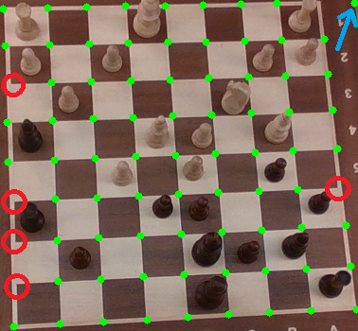
Checkerboard Corner Detection
What if some corners are not detected? Or some corners are wrongly detected?
Su

Slide 45
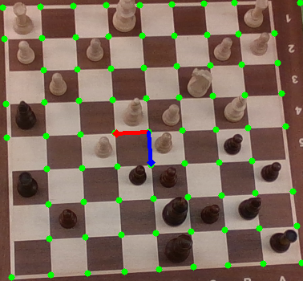
Checkerboard Corner Detection​
Predict vertical and horizontal edge vectors.
Median of existing vertical and horizontal vectors.
Su

Slide 46
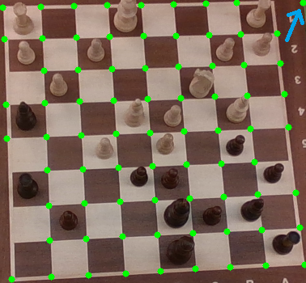
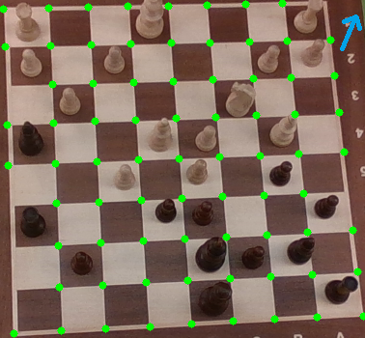
Checkerboard Corner Detection
For excess corners
If detected corner does not match with any of predicted corners, delete the corner.
Look at detected corner locations
Su

Slide 47
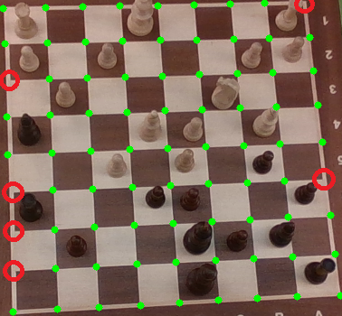
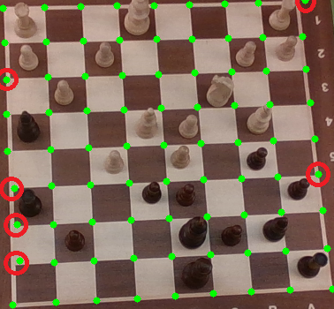
Checkerboard Corner Detection
For missing corners
Look at expected corner locations.
If corner exists pass, if corner does not exist add a corner.
Su

Slide 48
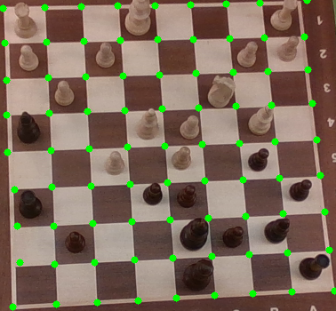
Checkerboard Corner Detection
Checkerboard Frame
Canny Edge Detection
Hough Line Transform
Sorting
Correct Corners
Harris Corner Detection
Sorted corner coordinates
Su

Slide 49
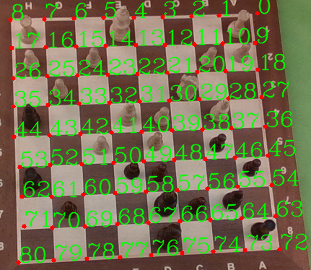
Checkerboard Corner Detection
Checkerboard Frame
Canny Edge Detection
Hough Line Transform
Sorting
Correct Corners
Harris Corner Detection
Sorted corner coordinates
Su

Slide 50
Piece Detection
Piece classes
Piece bounding boxes
Piece probabilities
Frame
Yolo Model
Su

Slide 51

Hand Detection: Intersection Over Union
1 if IoU > threshold
Hand Flag =
0 otherwise
Serden

Slide 52
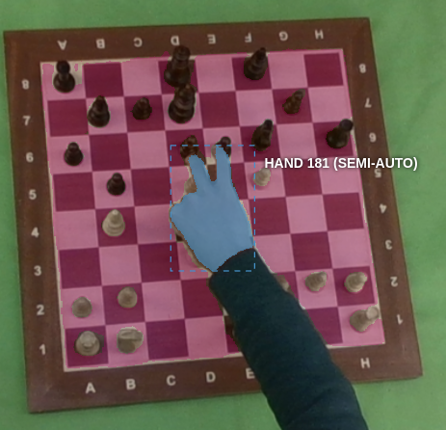
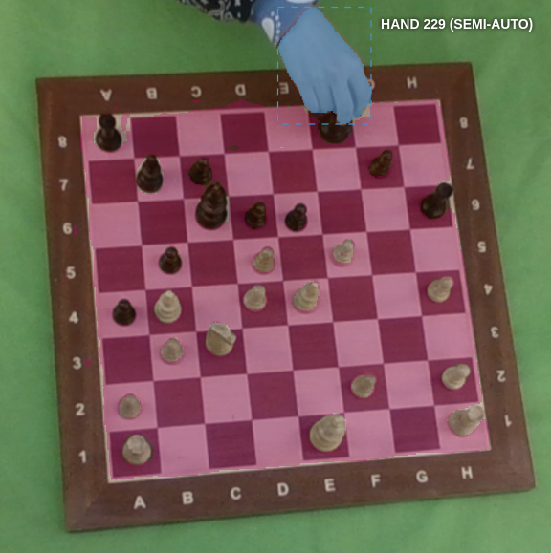
Intersection over Hand (IoH)
To understand what ratio of hand is over the checkerboard
Serden

Slide 53
GAME STATE

Slide 54
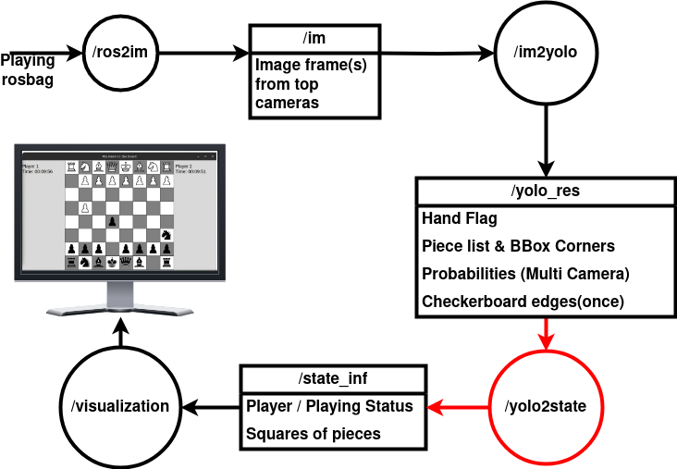
Game State Management
Veysel

Slide 55

Game State Management
Checkerboard coordinates
Hand flag
Piece classes
Piece bounding boxes
Piece probabilities
Chessboard
Player/Playing?
Veysel

Slide 56

Game State Management – State Machine
Veysel

Slide 57
Game State Management
Read the board only at the end of a move!
The reasons for the decision:
Avoid piece detection errors due to blockage of hand
Fasten the code
Veysel

Slide 58
Placing the Pieces into the Chessboard
We should evaluate the BBox and Checkerboard corners in order to determine the state of the board.
The implementation differs for single and multicamera scenarios.
Veysel

Slide 59

Chessboard Placement – Single Camera
Veysel

Slide 60

Chessboard Placement – Multicamera
Veysel

Slide 61
VISUALIZATION

Slide 62
Real-time visualization with Tkinter
Visualization is a subprocess.
Send game state to subprocess through open pipe.
Thread checks if data is on pipe and draws it.
Run in infinite loop
Visualization (Ros Node)
Visualization Script
Visualization Thread
Puts pieces on board
Serden

Slide 63

Real-time tracking of remaining times.
Veysel

Slide 64

Hand State on Title
4 State: P2s Move, P1s Move, P1s Hand on the board, P2s Hand on the board
Updated in the Tkinter window in real-time
Veysel

Slide 65

Hand State on Title
4 State: P2s Move, P1s Move, P1s Hand on the board, P2s Hand on the board
Updated in the Tkinter window in real-time
Veysel

Slide 66
PERFORMANCE COMPARISIONS

Slide 67
Accuracy calculation on run-time
Use a perfect YOLO model
Every piece is correctly classified
Now we can test accuracy by frame
Serden, Veysel

Slide 68

Confusion Matrix for overfitted model
Serden

Slide 69


Accuracy Results for YoloV8n (nano)
From 0.92 to 0.94 with the cost of delay
Mean performance is 0.9219
Serden

Slide 70


Accuracy Results for YoloV8s (small)
Single camera accuracy moved to 0.95 from 0.92 (YoloV8n)
Multi camera accuracy moved to 0.98 from 0.94 (YoloV8n)
Serden

Slide 71


Accuracy Results for YoloV8m (medium)
Single camera accuracy moved to 0.98 from 0.95 (YoloV8s)
Multi camera accuracy moved to 0.9875 from 0.9808 (YoloV8s)
Serden

Slide 72


Accuracy Results for YoloV8l (large)
Single camera accuracy moved to 0.97 from 0.98 (YoloV8m)
Multi camera accuracy moved to 0.9754 rom 0.9875 (YoloV8m)
Large model performs worse since we don't have enough data
Serden

Slide 73


Multi-view Camera: does it pay off?
It brings a marginal improvement over accuracy.
However, we need to detect corners at the beginning two times
Also with initialization, first delay is higher.
Serden

Slide 74


Multi-view Camera: stable after first frame
After initialization, it processes the frames in comparable times
Since medium model has more parameter, it takes more time to compute prediction than that of the small model
Serden

Slide 75

Delay: Multi vs. Single-Camera
Second camera is sequentially processed with the first one
That causes the delay to almost double for every node
Timings are given for small model
Serden

Slide 76

Delay: Multi vs. Single-Camera
Second camera is sequentially processed with the first one
That causes the delay to almost double for every node
Timings are given for medium model (increased w.r.t. to small)
Serden

Slide 77

The trade-off of speed and accuracy
Serden

Slide 78

DEMO: YoloV8m, MultiCamera

Slide 79

DEMO: YoloV8m, SingleCamera

Slide 80

DEMO: Single Camera with Ground Truth

Slide 81

FUTURE WORK
One node creates too much delay comparatively
Buffer of /im topic can become unstabilized
Suggestion: Re-arrange the node-topic pipeline for app. eq. Delays
Challenge: Each code snippet should be taken into account
Veysel

Slide 82
References
https://wiki.ros.org/message_filters/ApproximateTime
https://wiki.ros.org/message_filters#Overview
https://roboticsbackend.com/ros1-vs-ros2-practical-overview/
https://roboticsbackend.com/what-is-ros/
https://github.com/ultralytics/ultralytics
https://docs.opencv.org/3.4/dc/d0d/tutorial_py_features_harris.html
https://docs.opencv.org/3.4/d9/db0/tutorial_hough_lines.html

Slide 83
QUESTIONS

